Slide 1
Project On OOP Language
EMERGENCY ASSISTS

Slide 2
SUBMITTED TO
A.H.M Sajedul Hoque Shima Chakraborty
Assistant Professor Assistant Professor
Dept. of CSE Dept. of CSE
University of Chittagong University of Chittagong

Slide 3
Developed By
Name
ID Number
Jahedul Alam
Rehenuma Tasnim Rodoshi
Sazzad Hossain
Muntasha Sagufta
Priya Das
Partha Pratim Nath
Srabonti Dutta
14701005
14701029
14701038
14701055
14701059
14701065
14701071

Slide 4
OBJECTIVES OF THE APP
Provides help in danger
Sends message to preselected number
Sends current location of the user

Slide 5
SYSTEM FUNCTIONALITIES
Select contact numbers
Save numbers
Set emergency text
Save the text
Send text
Send location
Provide help for using the app

Slide 6
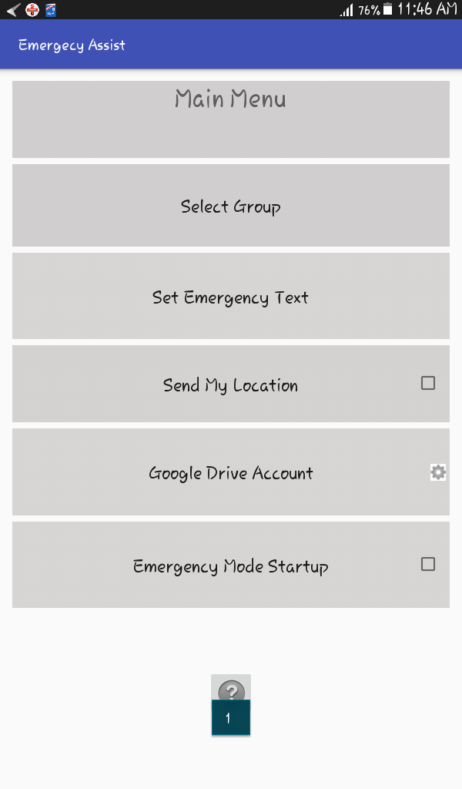
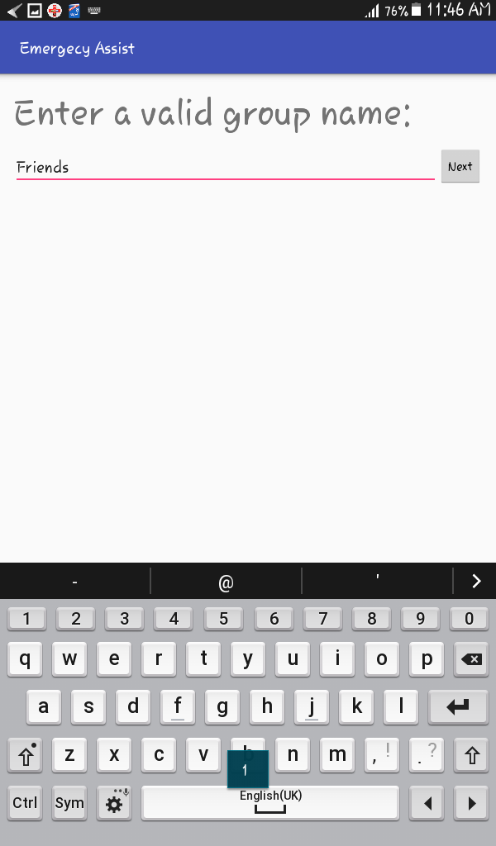
IMPLEMENTATION

Slide 7
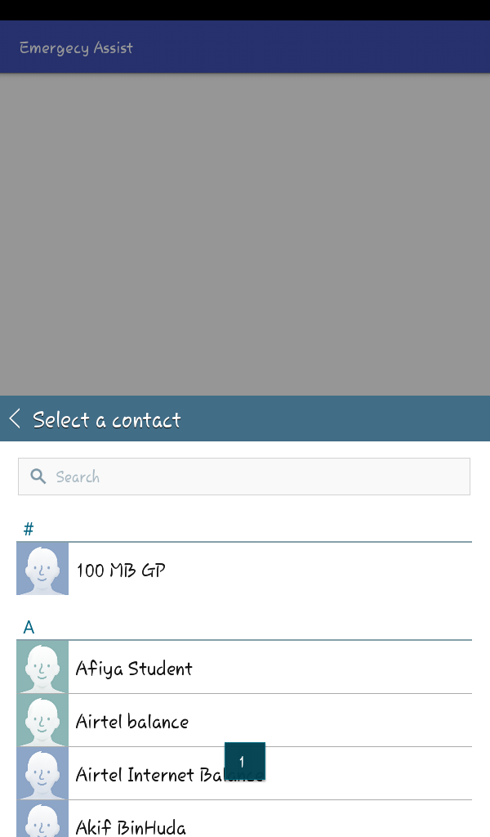
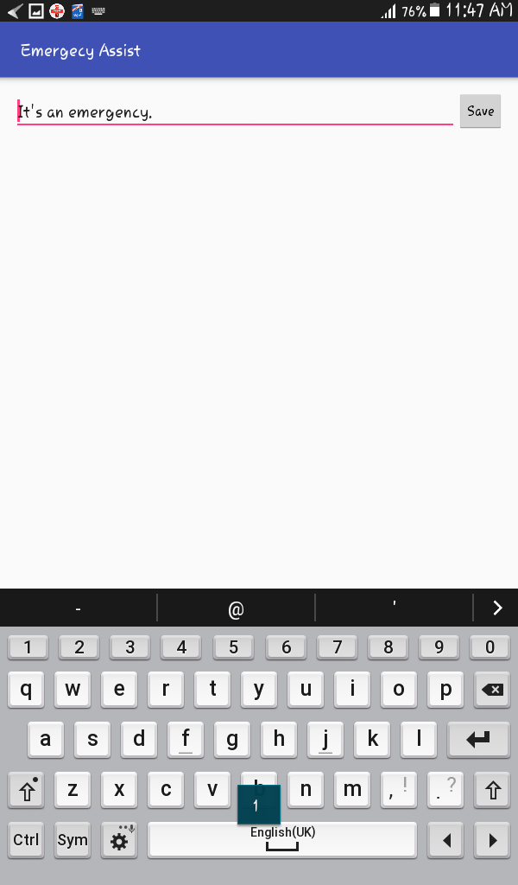
IMPLEMENTATION

Slide 8
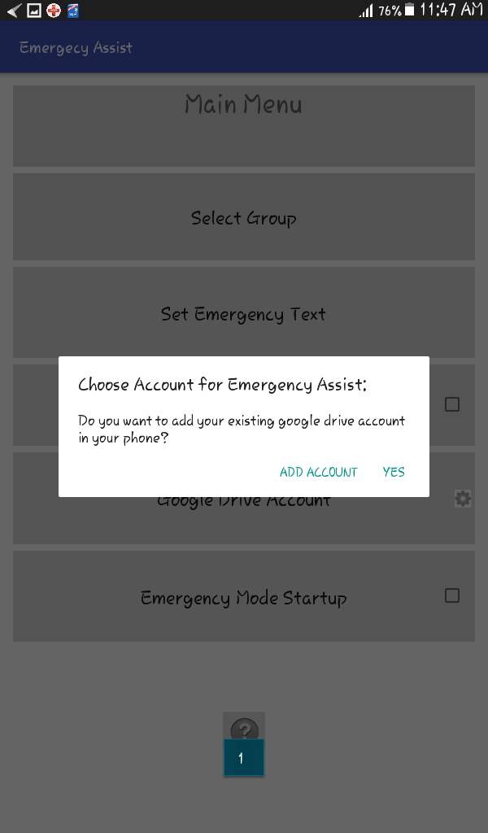
IMPLEMENTATION

Slide 9
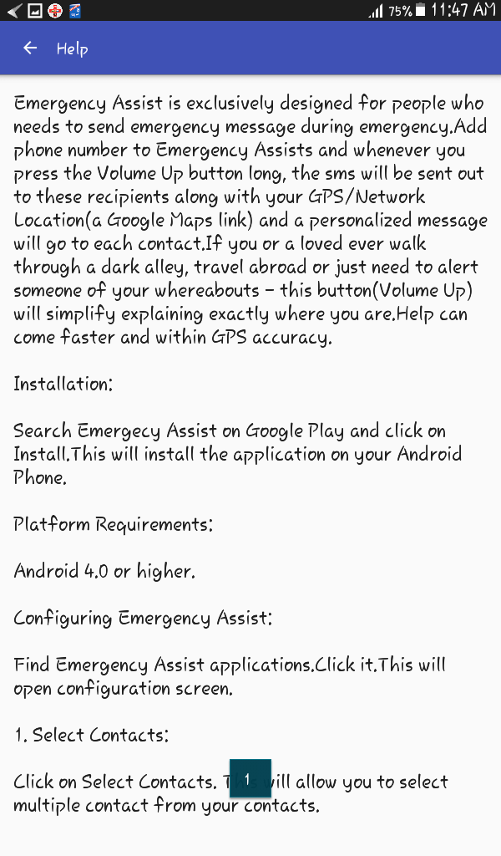
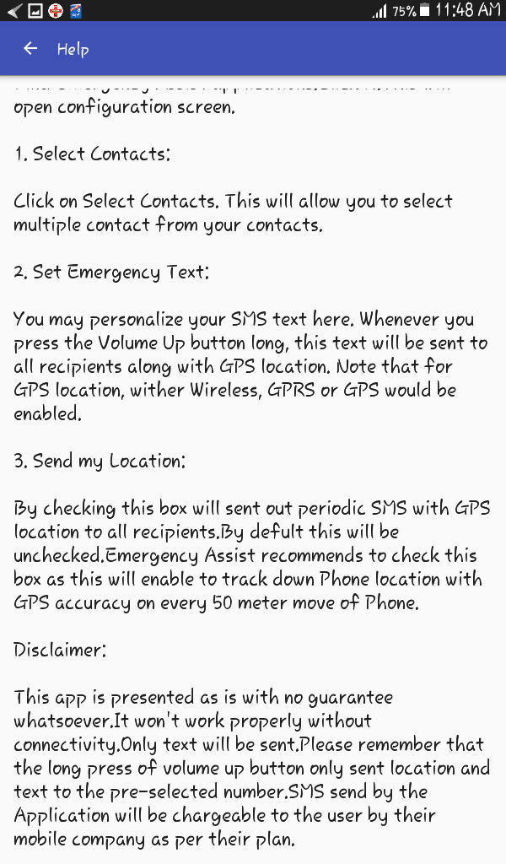
IMPLEMENTATION

Slide 10
CLASS DIAGRAM
Sendinglocation.class
Help.class
Main.class
Pickcontacts.class
Emergencytextmessaging.class

Slide 11
CONCLUSION
User friendly app
Be safe, because safety comes first

Slide 12
LIMITATIONS
Requires data connection

Slide 13
FUTURE PLANS
Develop with Software Engineering best practices
More features
More user-friendly
Better graphics

Slide 14
Thank you

